Slide 1
Classes and Objects
Chapter 03

Slide 2
Lecture’s Contents of Classes and Objects
Nature of an Object
Relationship among Objects
Nature of Class
Relationship among Classes

Slide 3
Class & Object
In Computer Science an object is any entity that can be manipulated by the commands of a Programming Language, such as a Value, Variable, Function or Data Structure. (With the later introduction of Object Oriented Programming the same word, "object", refers to a particular instance of a Class)

Slide 4
In object oriented programming, a class is a construct that is used as a blueprint (or template) to create objects of that class. This blueprint describes the state and behavior that the objects of the class all share. An object of a given class is called an instance of the class. The class that contains (and was used to create) instance can be considered as the type of that object, e.g. an object instance of the "Fruit" class would be of the type "Fruit".

Slide 5
A class usually represents a noun, such as a person, place or (possibly quite abstract) thing - it is a model of a concept within a computer program. Fundamentally, it encapsulates the state and behavior of the concept it represents. It encapsulates state through data placeholders called attributes (or member variables or instance variables); it encapsulates behavior through reusable sections of code called methods.

Slide 6
Objects
We begin at the beginning as a object. The world is made of objects. Just open your eyes and ears. They are out there. Bank customers, students, cats, elephants, cars, balls of string, atoms, molecules, tubs of ice cream, stars, bureaucrats, Robin Hood. The world is built of objects. Objects are built of smaller objects. Objects combine to make bigger objects. We already live in an object-oriented world.

Slide 7
Objects can be described by their attributes and operations. Attributes are the changeable characteristics of an object. Cats have colour, size, weight. Operations are the things an object does or can have done to it. Cats can catch mice, eat, worm up to owners, and be stroked. In our notation we draw an object such as a cat like this.

Slide 8
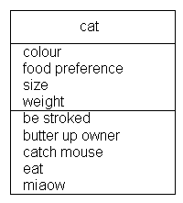
The name is shown at the top. The attributes are listed underneath. The operations are listed below that. Actually, strictly speaking, this is a class diagram. But we will explain that later.

Slide 9
In an object model, all data is stored as attributes of some object. The attributes of an object are manipulated by the operations. The only way of getting at the attributes is through an operation. Attributes may sometimes be objects in their own right (more of that later).
In an object model, all functionality is defined by operations. Objects may use each others operations, but the only legal way one object can manipulate another object is through an operation. An operation may inform, say "mass of ball", or change the state of an object, say "throw ball".

Slide 10
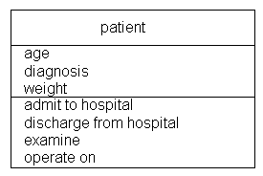
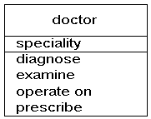
So, Object modelling is about finding objects, their attributes and their operations, and tying them together in an object model. Nothing more. Here are some more objects:

Slide 11










So, “An entity with a well-defined boundary and identity that encapsulates state and behavior. State is represented by attributes and relationships, behavior is represented by operations, methods. An object is an instance of a class.”
Examples of Objects
computer devices
persons
chairs

Slide 12
The ‘object’ forms the basis around, in which the following properties revolve:
  Encapsulation
  Abstraction,
  Inheritance, dynamic binding, polymorphism
  Overriding and overloading
Three properties characterize objects:
  Identity: the property of an object that distinguishes it from other objects
  State: describes the data stored in the object
  Behavior: describes the methods in the object's interface by which the object can be used

Slide 13
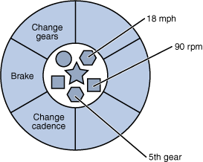
So, Objects are key to understanding object-oriented technology. Look around right now and you'll find many examples of real-world objects: your dog, your desk, your television set, your bicycle.
  Consider a bicycle, for example:
By attributing state (current speed, current pedal cadence, and current gear) and providing methods for changing that state, the object remains in control of how the outside world is allowed to use it. For example, if the bicycle only has 6 gears, a method to change gears could reject any value that is less than 1 or greater than 6.

Slide 14


Relationship among Objects
Relations between Objects
  Association ( structural relationship ) = cross-reference, uses, instance connection, relationship
  Generalisation = inheritance, subtype
  Aggregation = inclusion, containing, part-whole, consists of
Association and Links
  Association says there is a relation between 2 classes

Slide 15
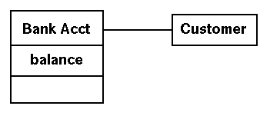
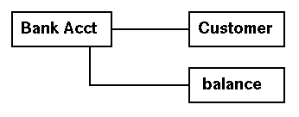
  An attribute is an association where the class is ``small enough'' to fit inside another class.
  We denote it using:
  rather than
  Whereas an association refers to a relationship between classes, the term link is used to refer to a structural relationship that exists between two specific objects ( instances ).

Slide 16
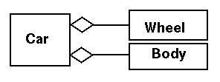
Aggregation
  Aggregation is a special form of association. Maybe referred to alternatively as:
  contains
  is composed of
  is comprised of
  is part of
Examples:
  A Car contains an Engine
  A Car contains a Transmission
  A Car contains a Body
  A Car is composed of many ( four, in this case ) Wheels

Slide 17
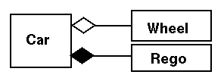
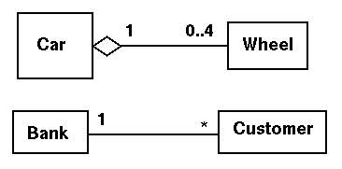
Composition
  Composition is the relation consists of where the components cannot exist independently from the whole. Wheels can exist independently from the car, and are not necessarily destroyed when the car is wrecked The car registration cannot exist without a car
Multiplicity
  One-to-one (1:1)
  One-to-many (1:m)
  Many-to-many (m:m)
  This can be shown on the association/aggregation /composition line, where `*' means zero or more

Slide 18
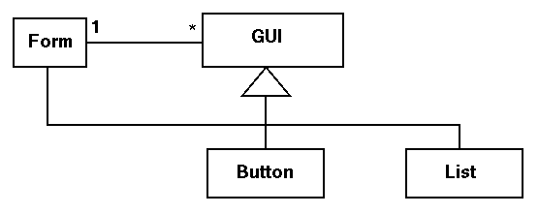
  The following says that a Form can contain many (different) GUI objects, including another Form. This is a potentially recursive structure
STUDENTS
M
**
COURCES

Slide 19
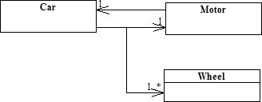
Composition (has)
The below diagram shows the "has-a" relationships between the Car, Motor and Wheel classes

Slide 20
What is Object Oriented?
‘Object-orientation’ is a term used to describe the object oriented method of building software.
In this approach, the data is treated as the most important element and it cannot flow freely around the system.
Restrictions (Limitation) are placed on the number of units that can manipulate the data.
Means, the approach binds (connect/combined) the data & the methods that will manipulate the data
Object oriented (OO) methods blend (unify) data and process into objects, and focuses on how those objects interact using methods (passing messages)

Slide 21

Traditional design creates entities (data tables), and changes them using scripts, procedures, macros, or other techniques
OOA&D creates objects from classes,
and applies them using their methods
or operations
In this given figure method1, method2, method3 & method4 manipulate the data.
This figure shows data is treated as a central figure and methods manipulate the data.

Slide 22
OOP – Object Oriented Programming
OOD – Object Oriented Design
OOA – Object Oriented Analysis
OOP:
  Object Oriented Programming is a method of implementation in which programs are organized as cooperative collections of objects.
  Each of which represents an instance of some class, and whose classes are all members of hierarchy of classes united via inheritance relationships.
  There are three important parts:
        Uses objects not algorithms, consists fundamental logical building blocks.
        Each object is an instance of some class and
        Classes are related to one another via inheritance relationship

Slide 23
  So, it satisfies the following requirements:
    Supports objects that are data abstractions with an interface of named operations & a hidden local state.
    Objects have an associated type that is class.
    Types classes may inherit attributes from super type that is super class.
OOD:
  Object Oriented Design is a method of design encompassing the process of object oriented decomposition and
  It is a notation for depicting (show) both logical and physical as well as static and dynamic models of the system under design.
  There are two important parts:
        Leads to an object-oriented decomposition and
        Uses different notations to express different models of the logical (class & object structure) and physical (module & process architecture) design of the system.

Slide 24
OOA:
  Object Oriented Analysis is a method of analysis that examines requirements from the perspective of the classes and objects.
  So, the object oriented analysis serve as the models from which may start an object oriented design.

Slide 25
What is a Class?
“A description of a set of objects that share the same attributes, operations, methods, relationships, and semantics. A class may use a set of interfaces to specify collections of operations it provides to its environment.”
Hence a class is a group of similar objects

Slide 26
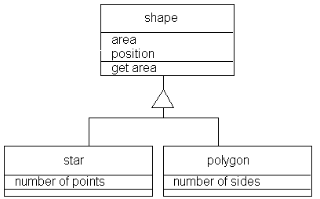

Slide 27

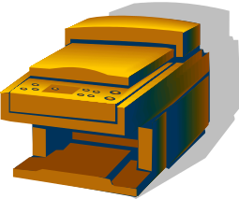

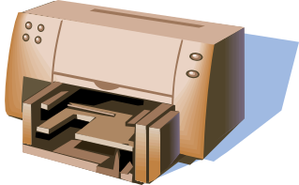

Class Example
Printers
information
behaviour

Slide 28
Relationship among Classes
Class Relationships
Classes, by themselves, aren't particularly useful. It’s the relationships among classes that provide the foundation for the structure of a new system. The following sections explore how you use the UML to illustrate various kinds of class relationships.
Associations An association is a simple structural connection between classes.
There are two basic kinds of associations: binary associations and n-ary associations.

Slide 29
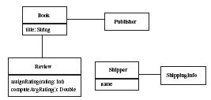
Class Relationships
A binary association, which exists between two classes, appears as a straight line that connects them. Figure 2-1 shows some example associations between classes.
Figure 2-1. Binary associations
Associations An association is a simple structural connection between classes.
There are two basic kinds of associations: binary associations and n-ary associations. M

Slide 30
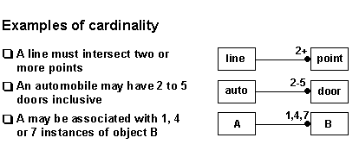
Binary Association:
In a binary association is fully described by indicating:
Each class' relationship with the other
Its cardinality and
Its optionality.
Cardinality is expressed in terms of:
one to one
one to many
many to many

Slide 31

N-ary Association:
An n-ary association, which exists among three or more classes, appears as a set of lines connected to a central diamond.
The n-ary association is considered something of an advanced modeling construct; you’re much more likely to see—and use—plain binary associations in your models.

Slide 32
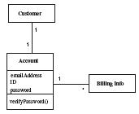
Multiplicity Association:
An association can show multiplicity. Figure the examples of association multiplicity.
A ternary association describes a fact that involves three classes and cannot be split up into component binary associations without losing information. For example, when a seller negotiates a price with a buyer through an agent, a decomposition of the ternary into two binary associations between buyer and seller and seller and agent would lose the information on which buyer was involved in the deal between the seller and agent.

Slide 33
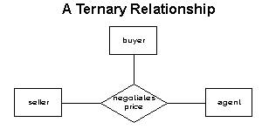
Ternary Association:
A ternary association describes a fact that involves three classes and cannot be split up into component binary associations without losing information. For example, when a seller negotiates a price with a buyer through an agent, a decomposition of the ternary into two binary associations between buyer and seller and seller and agent would lose the information on which buyer was involved in the deal between the seller and agent.
A ternary association is described in terms of the role that each class plays in the association. For example:
An agent negotiates a price between a buyer and a seller
A buyer negotiates a price with a seller through an agent
A seller negotiates a price with a buyer through an agent

Slide 34
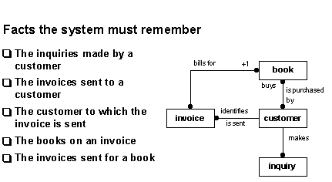
Example

Slide 35
Overview of Various OOAD Methodologies
Booch Methodology:
  Grady Booch’s approach to OOAD is supported various tools like Visio and Rational Rose.
  It covers requirement and domain analysis but its major strength is in design.
Coad and Yourdon Methodology:
  The Coad and Yourdon methodology focuses on analyzing the business problems. The analysis process has five stages:
  Subject
  Objects
  Structures
  Attributes
  Services

Slide 36
OO Objectives
We want a development method which:
  is able to guide us through analysis, design, and implementation using one consistent paradigm throughout those phases
  is less likely to generate errors
  contains checks to help eliminate errors
  facilitates reuse of designs and code

Slide 37
The End

